Slide 1
Graph Traversal
COMP9312_22T2

Slide 2
Outline
- BFS
- DFS
- Connectivity
- Topological sort

Slide 3
Breath-first and depth-first traversals

Slide 4
Strategies
Traversals of graphs are also called searches
Applications of BFS
Shortest Path
…
Applications of DFS
Strongly connected component
Topological Order
…
A quick view:
https://seanperfecto.github.io/BFS-DFS-Pathfinder/

Slide 5
Breadth-first traversal
Consider implementing a breadth-first traversal on a graph:
Choose any vertex, mark it as visited and push it onto queue
While the queue is not empty:
Pop to top vertex v from the queue
For each vertex adjacent to v that has not been visited:
Mark it visited, and
Push it onto the queue
This continues until the queue is empty
Note: if there are no unvisited vertices, the graph is connected
The size of the queue is at most O(|V|)
Notes:
The size depends both on:
The number of edges, and
The degree of the vertices

Slide 6
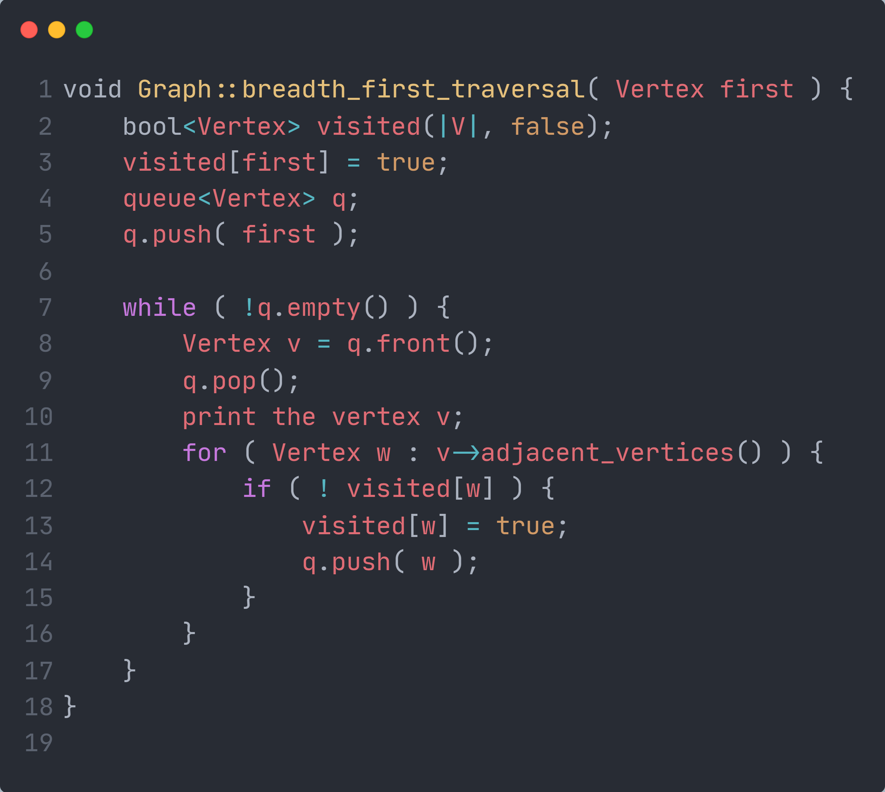
Breadth-First Traversal
An implementation can use a queue
Notes:
void Graph::breadth_first_traversal( Vertex first ) {
bool<Vertex> visited(|V|, false);
visited[first] = true;
queue<Vertex> queue;
queue.push( first );
while ( !queue.empty() ) {
Vertex v = queue.front();
queue.pop();
print the vertex v;
for ( Vertex w : v->adjacent_vertices() ) {
if ( ! visited[w] ) {
visited[w] = true;
queue.push( w );
}
}
}
}

Slide 7
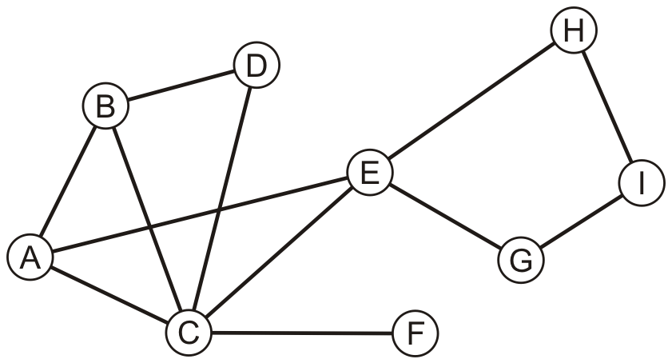
Example
Consider this graph

Slide 8
Example
Performing a breadth-first traversal
Push the first vertex onto the queue
A

Slide 9
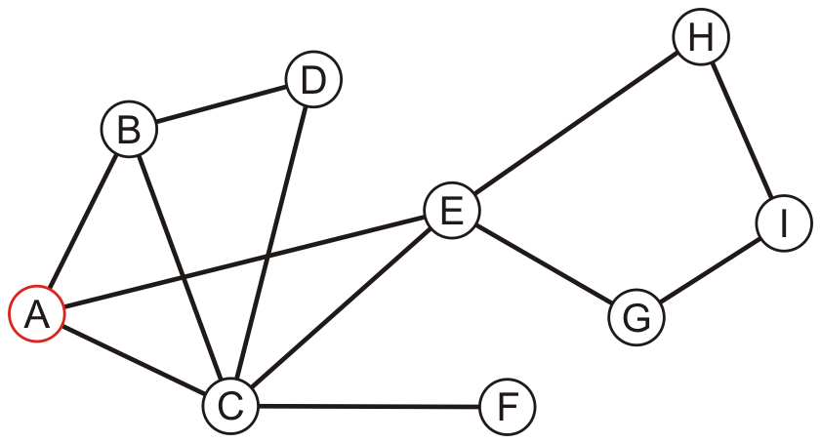
Example
Performing a breadth-first traversal
Pop A and push B, C and E
A
B | C | E

Slide 10
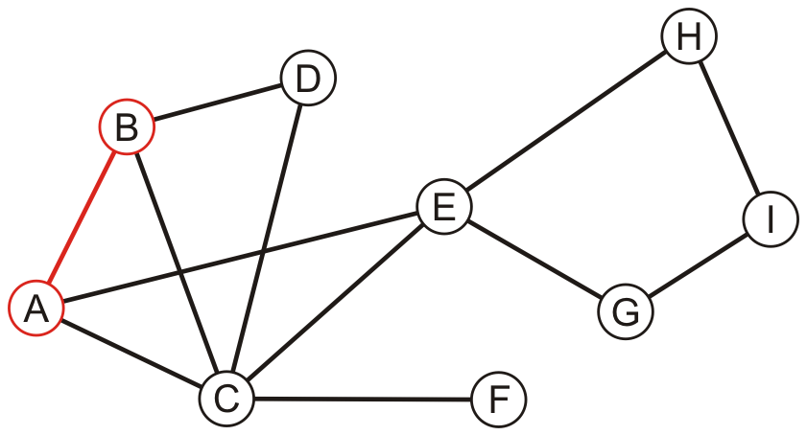
Example
Performing a breadth-first traversal:
Pop B and push D
A, B
C | E | D

Slide 11
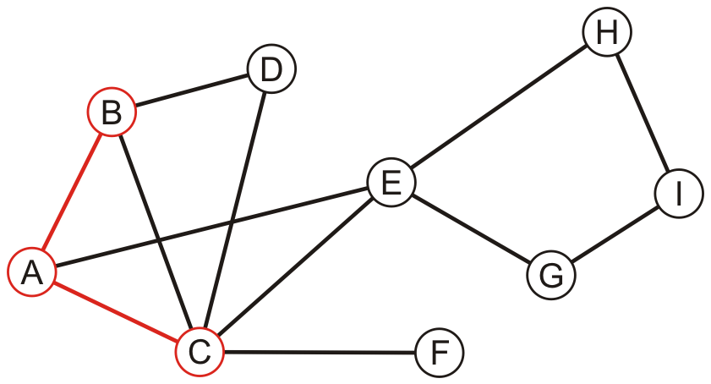
Example
Performing a breadth-first traversal:
Pop C and push F
A, B, C
E | D | F

Slide 12
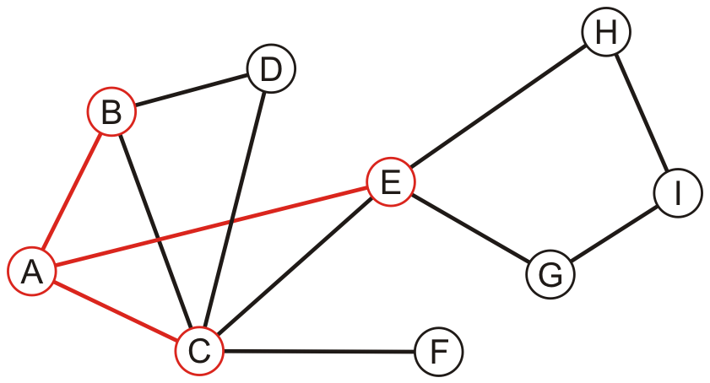
Example
Performing a breadth-first traversal:
Pop E and push G and H
A, B, C, E
D | F | G | H

Slide 13
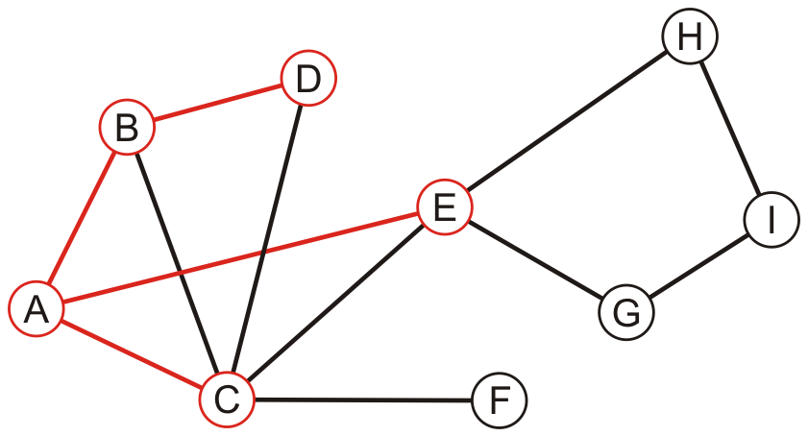
Example
Performing a breadth-first traversal:
Pop D
A, B, C, E, D
F | G | H

Slide 14
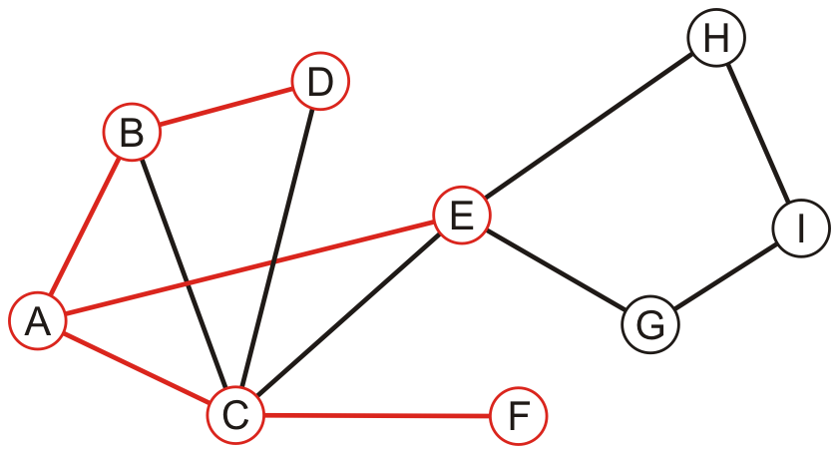
Example
Performing a breadth-first traversal:
Pop F
A, B, C, E, D, F
G | H

Slide 15
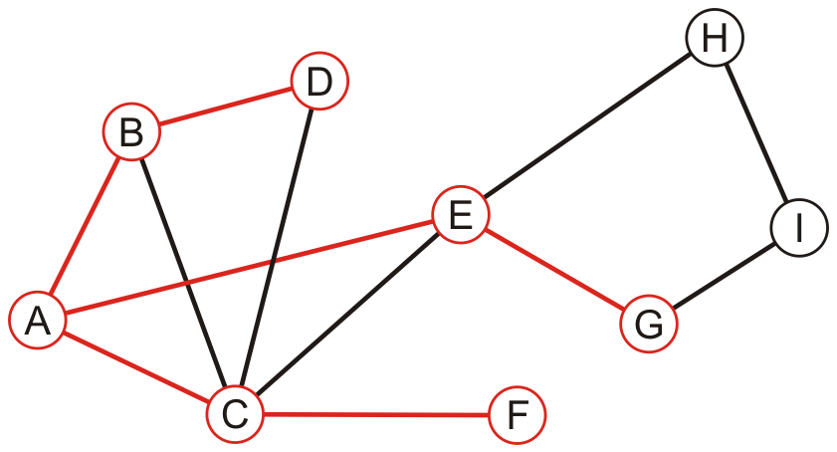
Example
Performing a breadth-first traversal:
Pop G and push I
A, B, C, E, D, F, G
H | I

Slide 16
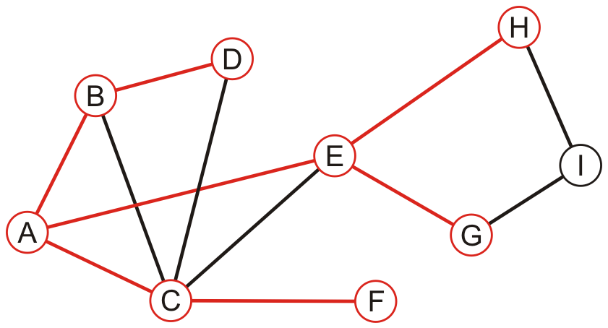
Example
Performing a breadth-first traversal:
Pop H
A, B, C, E, D, F, G, H
I

Slide 17
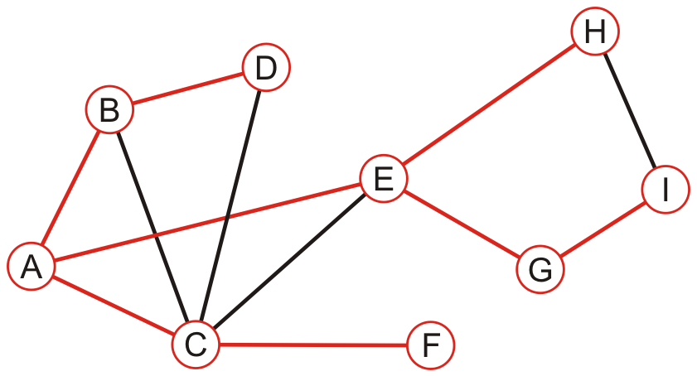
Example
Performing a breadth-first traversal:
Pop I, The queue is empty: we are finished
A, B, C, E, D, F, G, H, I

Slide 18
BFS
Coding practice~
Number of iterations: diameter

Slide 19
Depth-First Traversal
Consider implementing a depth-first traversal on a graph:
Choose any vertex, mark it as visited
From that vertex:
If there is another adjacent vertex not yet visited, go to it
Otherwise, go back to the last vertex that has not had all of its adjacent vertices visited and continue from there
Continue until no visited vertices have unvisited adjacent vertices
Two implementations:
Recursive approach (a statement in a function calls itself repeatedly)
Iterative approach (a loop repeatedly executes until the controlling condition becomes false)
Notes:
recursion is a process, always applied to a function and iteration is applied to the set of instructions which we want to get repeatedly executed.

Slide 20
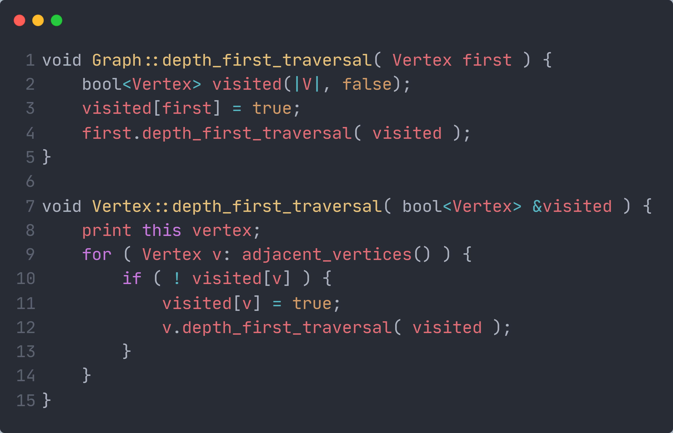
Recursive depth-first traversal
A recursive implementation uses the call stack for memory:
Notes:
void Graph::depth_first_traversal( Vertex first ) {
bool<Vertex> visited(|V|, false);
visited[first] = true;
first.depth_first_traversal( visited );
}
void Vertex::depth_first_traversal( bool<Vertex> &visited ) {
print this vertex;
for ( Vertex v: adjacent_vertices() ) {
if ( ! visited[v] ) {
visited[v] = true;
v.depth_first_traversal( visited );
}
}
}

Slide 21
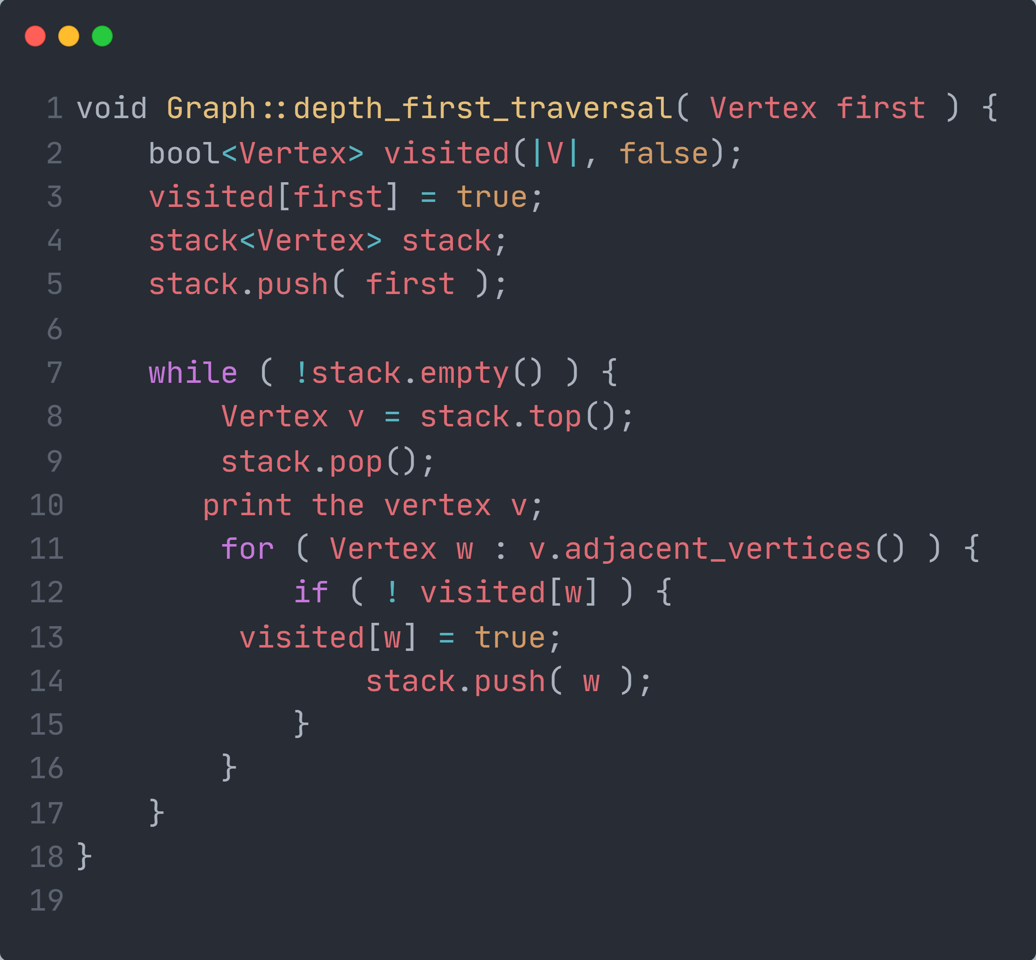
Iterative depth-first traversal
An iterative implementation can use a stack
Notes:
void Graph::depth_first_traversal( Vertex first ) {
bool<Vertex> visited(|V|, false);
visited[first] = true;
stack<Vertex> stack;
stack.push( first );
while ( !stack.empty() ) {
Vertex v = stack.top();
stack.pop();
print the vertex v;
for ( Vertex w : v.adjacent_vertices() ) {
if ( ! visited[w] ) {
visited[w] = true;
stack.push( w );
}
}
}
}

Slide 22
Example
Perform a recursive depth-first traversal on this same graph

Slide 23
Example
Performing a recursive depth-first traversal:
Visit the first node
A

Slide 24
Example
Performing a recursive depth-first traversal:
A has an unvisited neighbor
A, B

Slide 25
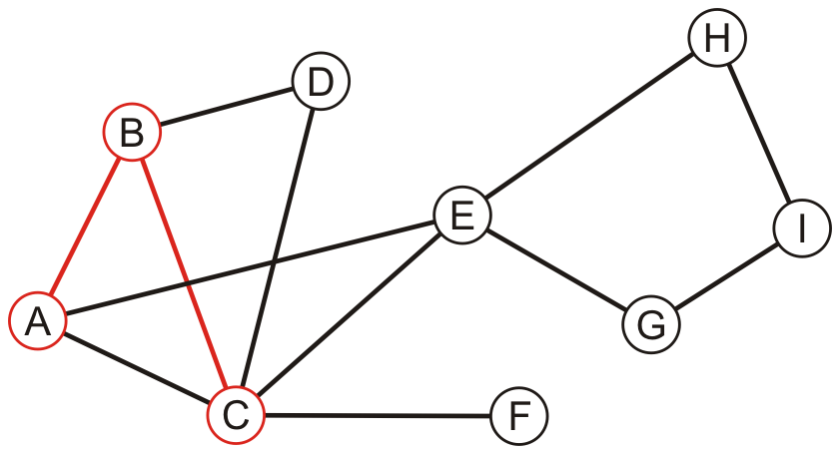
Example
Performing a recursive depth-first traversal:
B has an unvisited neighbor
A, B, C

Slide 26
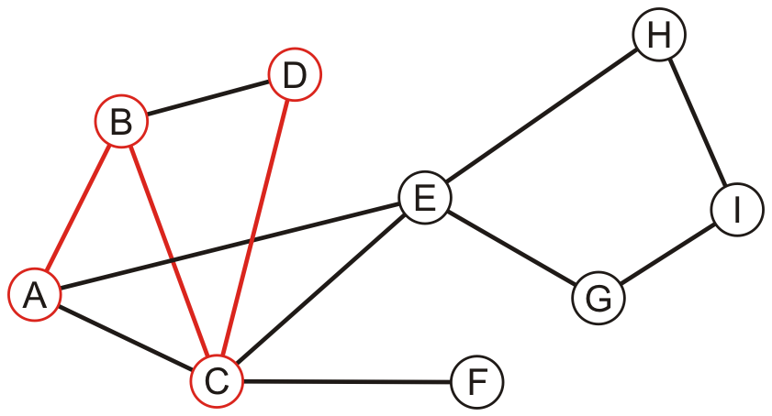
Example
Performing a recursive depth-first traversal:
C has an unvisited neighbor
A, B, C, D

Slide 27
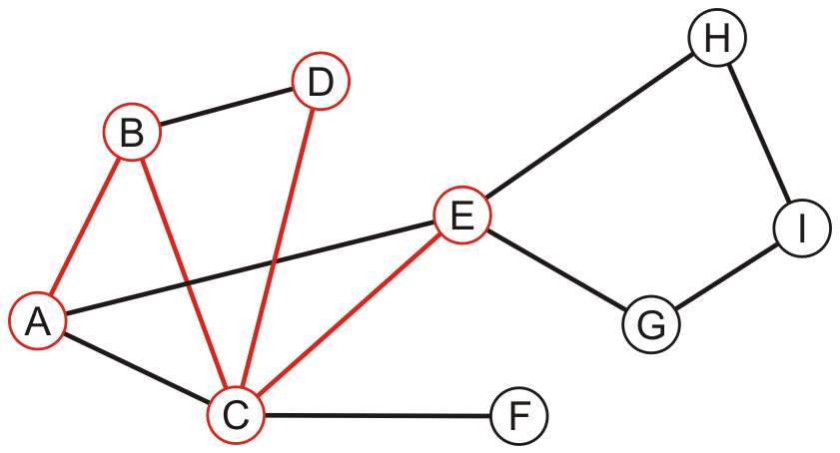
Example
Performing a recursive depth-first traversal:
D has no unvisited neighbors, so we return to C
A, B, C, D, E

Slide 28
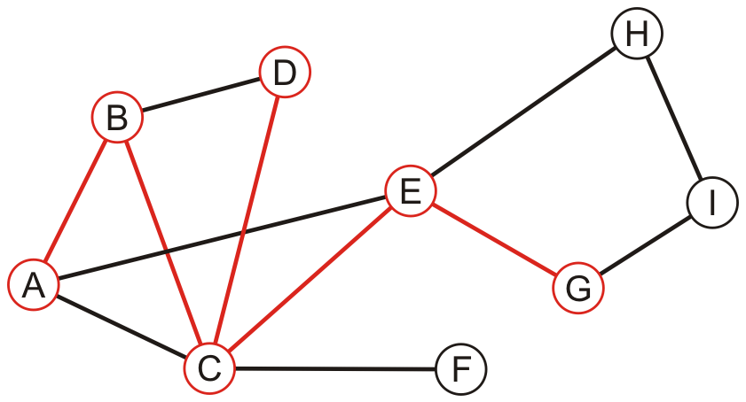
Example
Performing a recursive depth-first traversal:
E has an unvisited neighbor
A, B, C, D, E, G

Slide 29
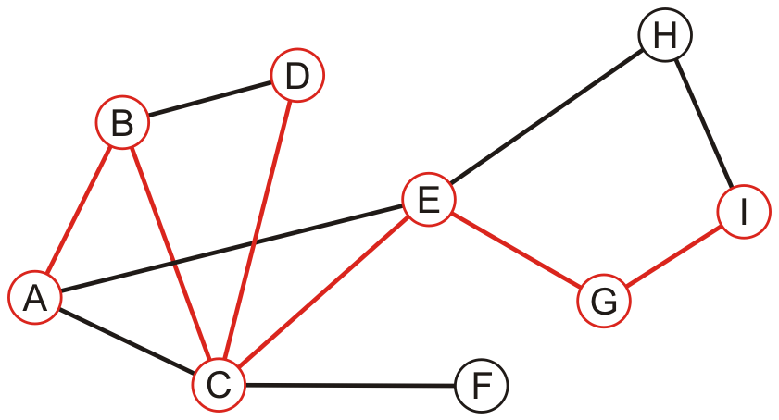
Example
Performing a recursive depth-first traversal:
G has an unvisited neighbor
A, B, C, D, E, G, I

Slide 30
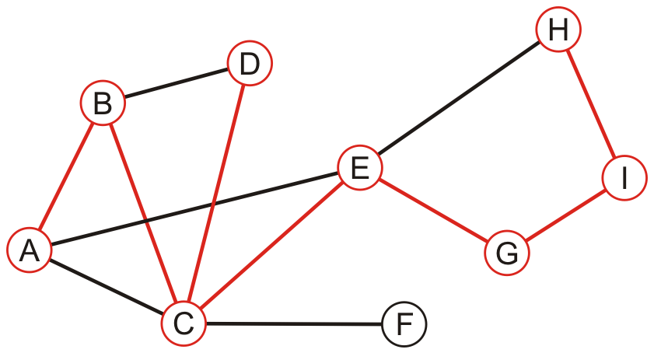
Example
Performing a recursive depth-first traversal:
I has an unvisited neighbor
A, B, C, D, E, G, I, H

Slide 31
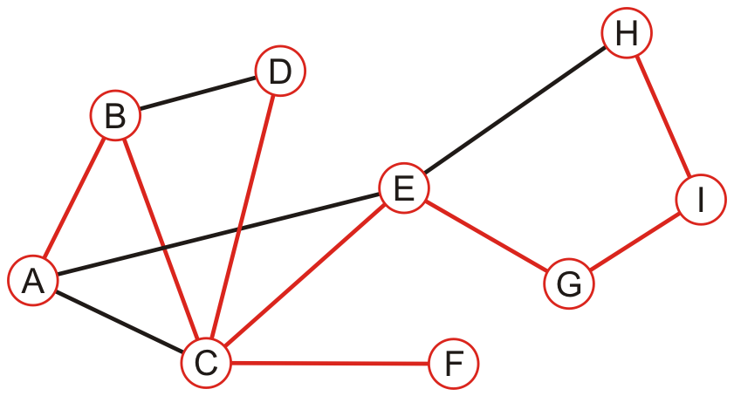
Example
Performing a recursive depth-first traversal:
We recurse back to C which has an unvisited neighbour
A, B, C, D, E, G, I, H, F

Slide 32
Example
Performing a recursive depth-first traversal:
We recurse finding that no other nodes have unvisited neighbours
A, B, C, D, E, G, I, H, F

Slide 33
Comparing BFS and DFS
The order can differ greatly
An iterative depth-first traversal may also be different again
BFS: A, B, C, E, D, F, G, H, I
Recursive DFS: A, B, C, D, E, G, I, H, F

Slide 34
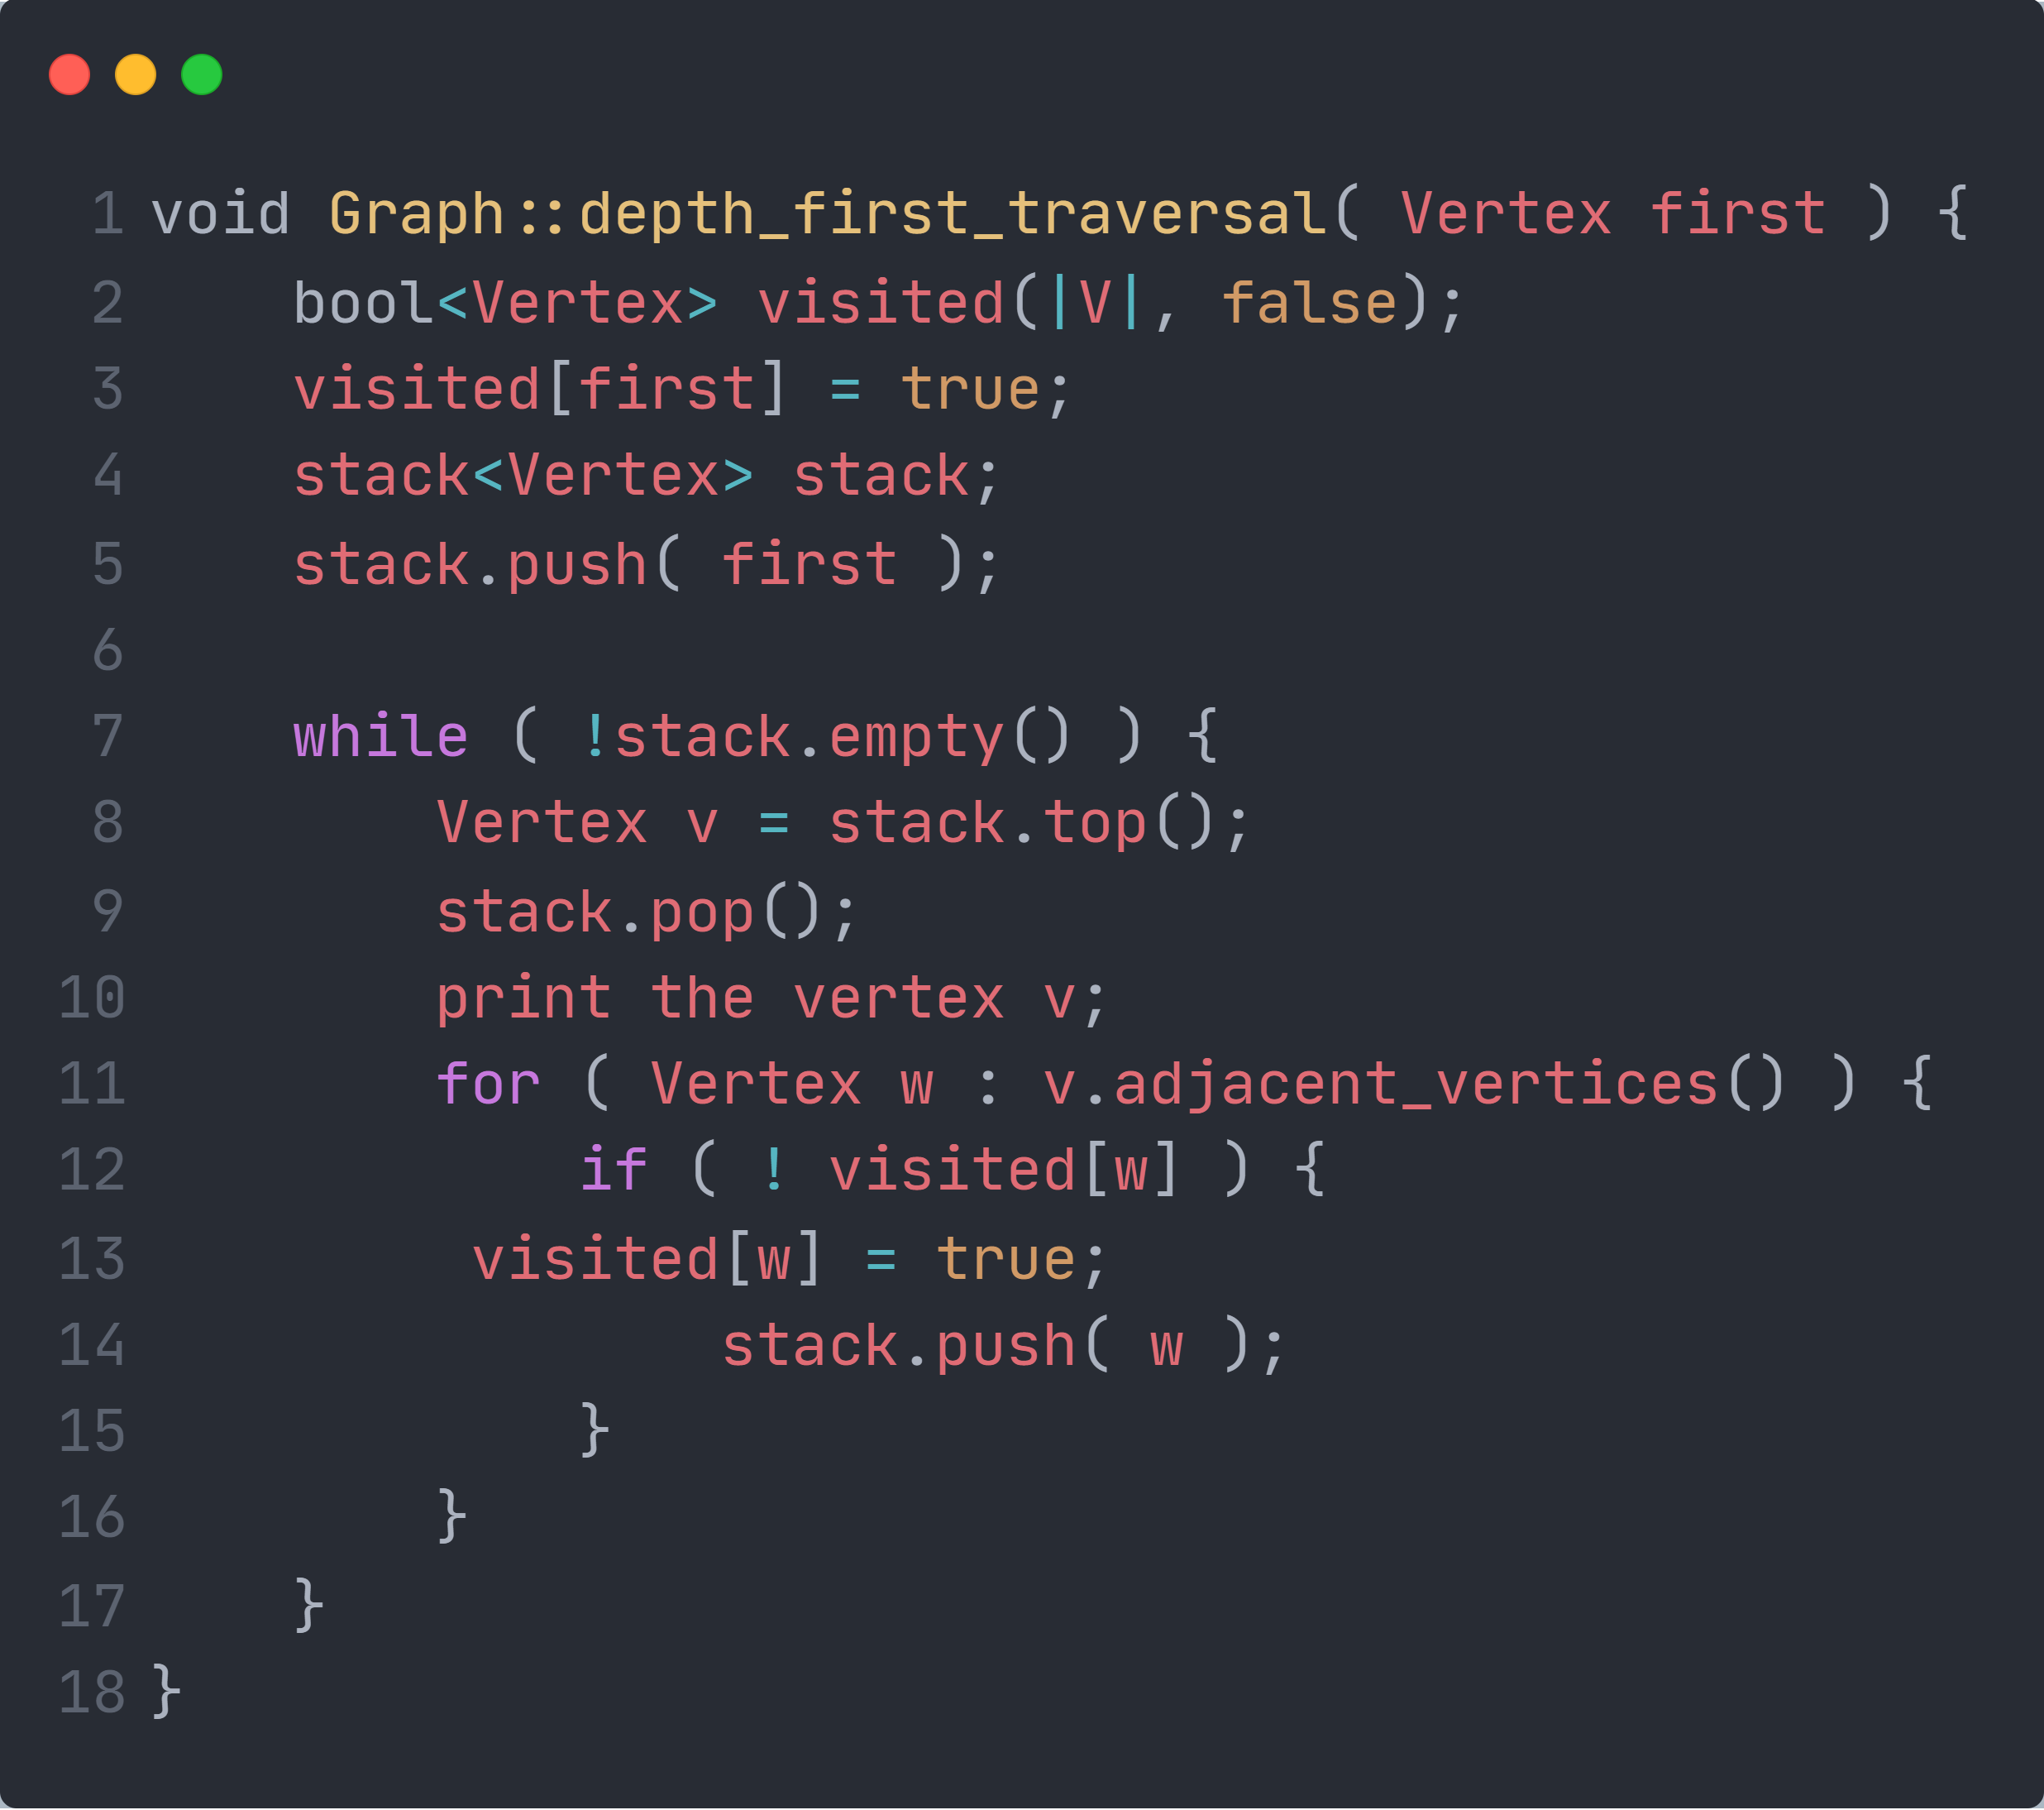
Quick quiz
Can you show the result of iterative depth-first traversal?
H
D
B
E
I
A
G
C
F
Notes:
void Graph::depth_first_traversal( Vertex first ) {
bool<Vertex> visited(|V|, false);
visited[first] = true;
stack<Vertex> stack;
stack.push( first );
while ( !stack.empty() ) {
Vertex v = stack.top();
stack.pop();
print the vertex v;
for ( Vertex w : v.adjacent_vertices() ) {
if ( ! visited[w] ) {
visited[w] = true;
stack.push( w );
}
}
}
}

Slide 35
Example
Performing an iterative depth-first traversal:
Push the first vertex onto the stack
H
D
A
B
E
I
A
G
C
F

Slide 36
Example
Performing an iterative depth-first traversal:
Pop A and push B, C and E
A
H
D
E
C
B
B
E
I
A
G
C
F

Slide 37
Example
Performing an iterative depth-first traversal:
Pop E and push G and H
A, E
H
D
H
G
C
B
B
E
I
A
G
C
F

Slide 38
Example
Performing an iterative depth-first traversal:
Pop H and push I
A, E, H
H
D
I
G
C
B
B
E
I
A
G
C
F

Slide 39
Example
Performing an iterative depth-first traversal:
Pop I
A, E, H, I
H
D
G
C
B
B
E
I
A
G
C
F

Slide 40
Example
Performing an iterative depth-first traversal:
Pop G
A, E, H, I, G
H
D
C
B
B
E
I
A
G
C
F

Slide 41
Example
Performing an iterative depth-first traversal:
Pop C and push D and F
A, E, H, I, G, C
H
D
F
D
B
B
E
I
A
G
C
F

Slide 42
Example
Performing an iterative depth-first traversal:
Pop F
A, E, H, I, G, C, F
H
D
D
B
B
E
I
A
G
C
F

Slide 43
Example
Performing an iterative depth-first traversal:
Pop D
A, E, H, I, G, C, F, D
H
D
B
B
E
I
A
G
C
F

Slide 44
Example
Performing an iterative depth-first traversal:
Pop B
A, E, H, I, G, C, F, D, B
H
D
B
E
I
A
G
C
F

Slide 45
Complexity Analysis
We have to track which vertices have been visited requiring Ο(|V|) memory
The time complexity cannot be better than and should not be worse than Ο(|V| + |E|)
Connected graphs simplify this to Ο(|E|) – Why?
Notes:
Why: because the number of edges is at least the number of vertices – 1 <a tree>
When: when the graph is a complete graph

Slide 46
DFS: Recursive VS stack-based
Coding practice~
Which one is better?
https://docs.google.com/forms/d/e/1FAIpQLSdrFDB9mq3nHhpufQ0p7MuuGH41e36DkJFg1r8Rv_S4iFaogQ/viewform?usp=sf_link
Notes:
Why: because the number of edges is at least the number of vertices – 1 <a tree>
When: when the graph is a complete graph

Slide 47
Summary
This topic covered graph traversals
Considered breadth-first and depth-first traversals
Depth-first traversals can recursive or iterative
Considered an example with both implementations
They are also called searches

Slide 48
*Recent Research on DFS/BFS
Dynamic Graphs
When graph updates (new edge inserts or old edge removes)
Compute DFS from scratch
VS
Update DFS tree

Slide 49
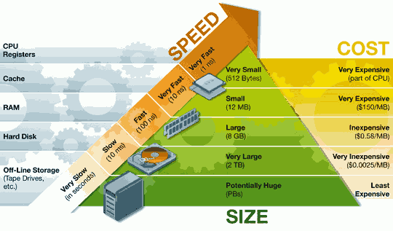
*Recent Research on DFS/BFS
External Memory Algorithms
If there is no enough memory to store the whole graph,
how to compute DFS

Slide 50
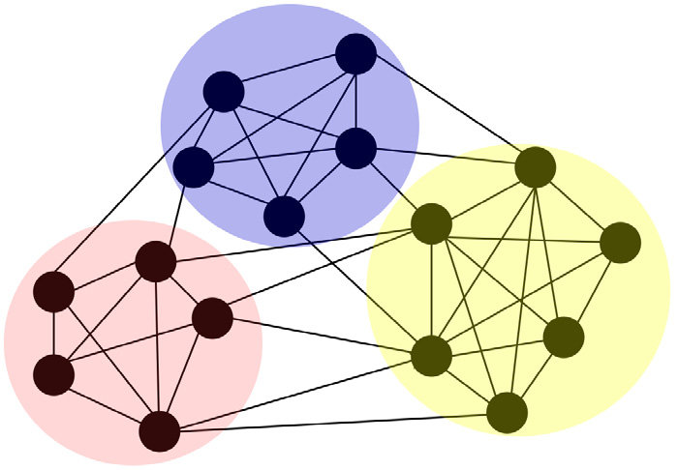
*Recent Research on DFS/BFS
Distributed Algorithms
The information (neighbors) of different vertices locate in different machines.
Distributed DFS algorithm is hard.

Slide 51
Connectivity

Slide 52
Connectivity
We will use graph traversals to determine:
Whether one vertex is connected to another
The connected sub-graphs of a graph
First, let us determine whether one vertex is connected to another
v_{j} is connected to v_{k} if there is a path from v_{j} to v_{k}
Strategy:
Perform a breadth-first traversal starting at v_{j}
While looping, if the vertex v_{k} ever found to be adjacent to the front of the queue, return true
If the loop ends, return false

Slide 53
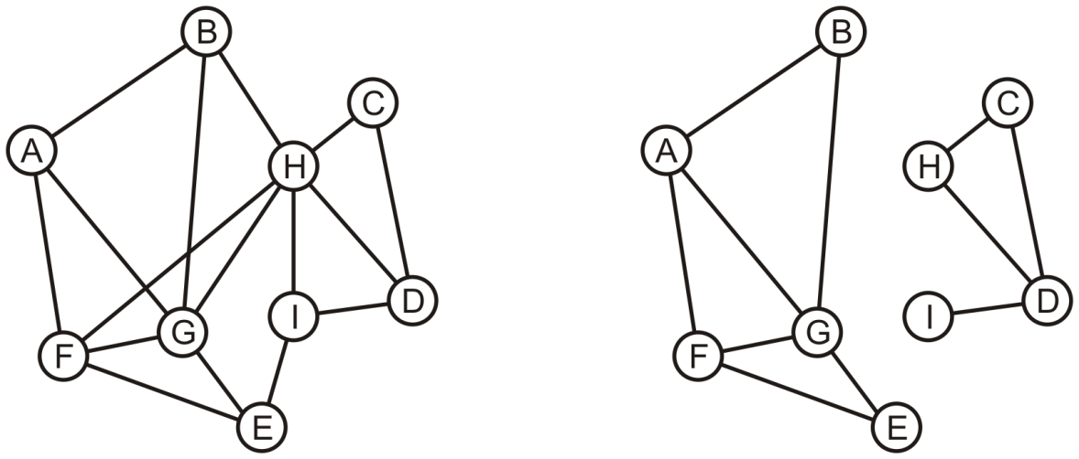
Determining Connections
Is A connected to D?

Slide 54
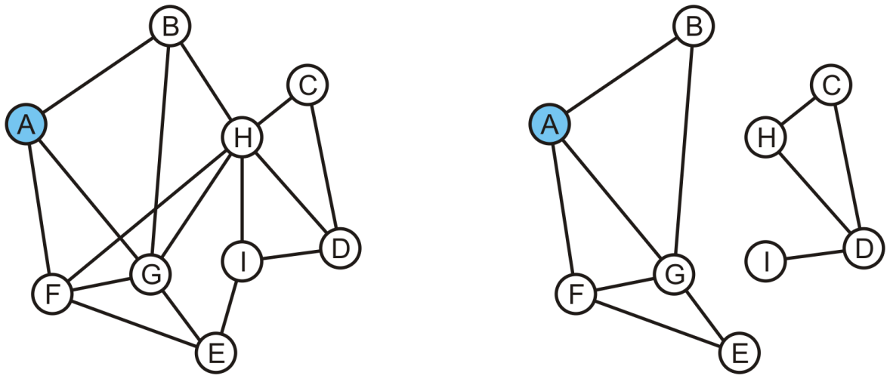
Determining Connections
Vertex A is marked as visited and pushed onto the queue
A
A

Slide 55
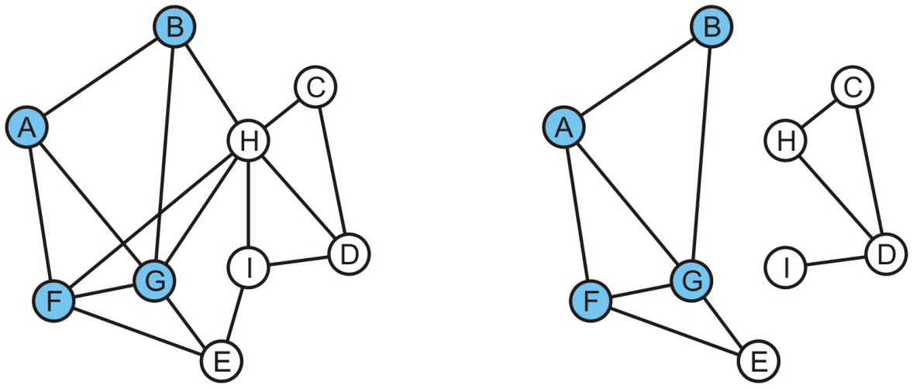
Determining Connections
Pop the head, A, and mark and push B, F and G
B | F | G
B | F | G

Slide 56
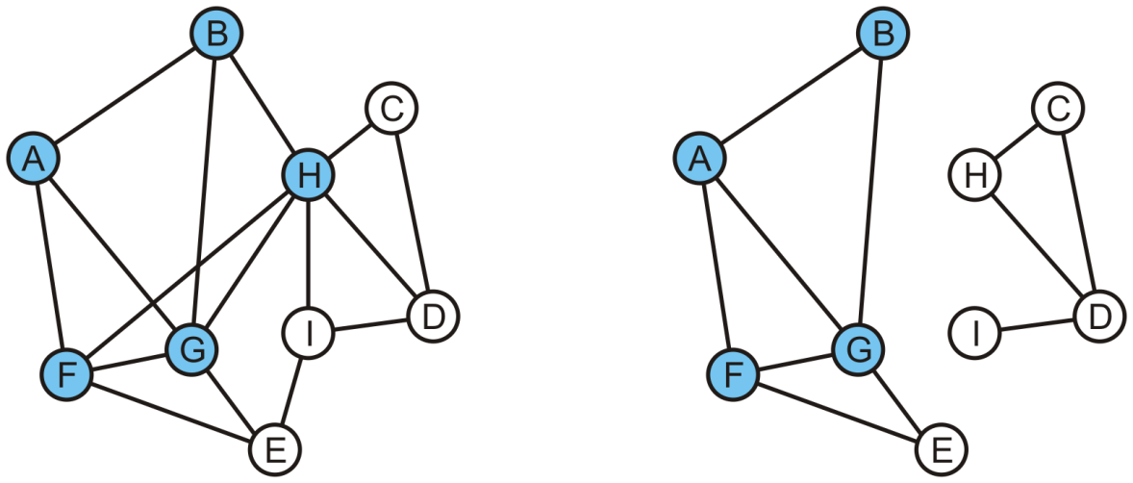
Determining Connections
Pop B and mark and, in the left graph, mark and push H
On the right graph, B has no unvisited adjacent vertices
F | G | H
F | G

Slide 57
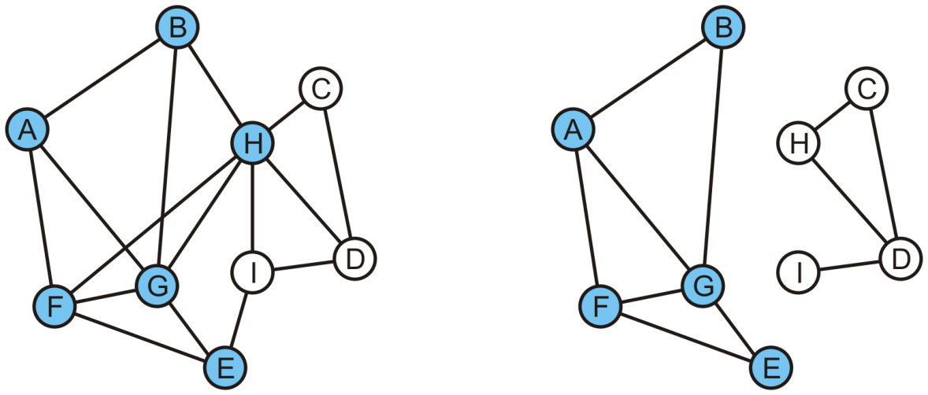
Determining Connections
Popping F results in the pushing of E
G | H | E
G | E

Slide 58
Determining Connections
In either graph, G has no adjacent vertices that are unvisited
H | E
E

Slide 59
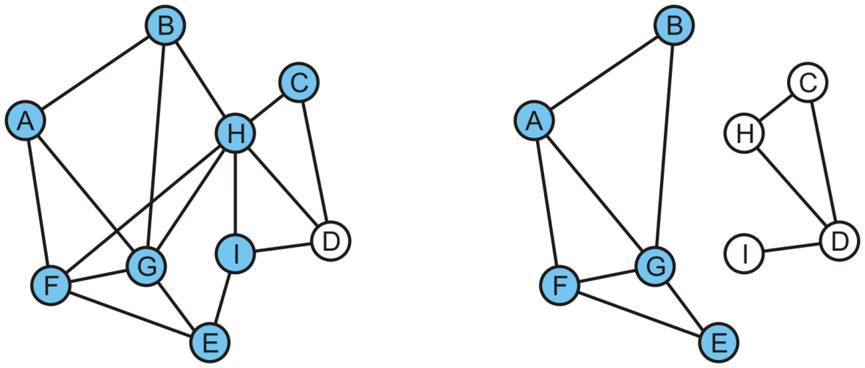
Determining Connections
Popping H on the left graph results in C and I being pushed
C | I | D

Slide 60
Determining Connections
The queue op the right is empty
We determine A is not connected to D
C | I | D

Slide 61
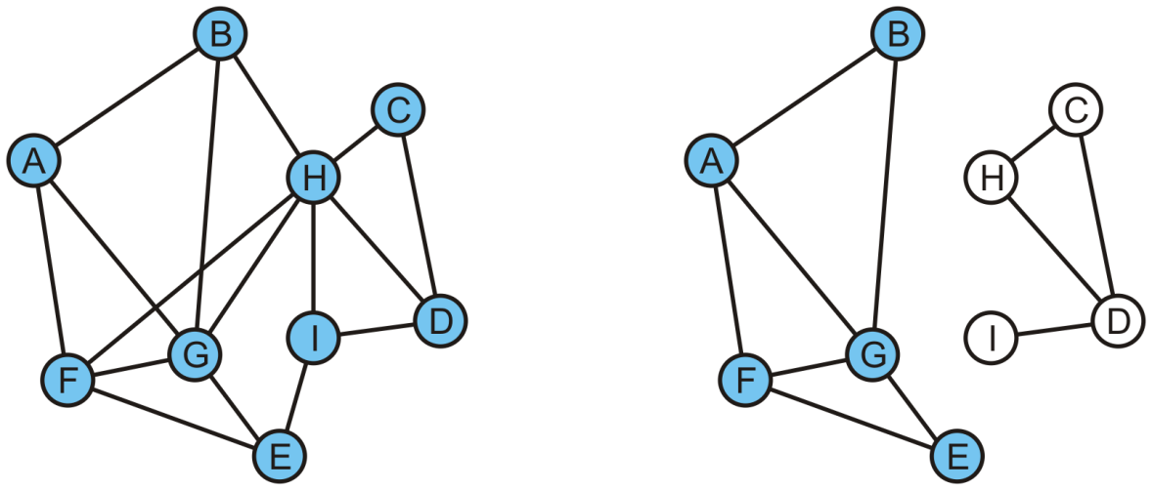
Determining Connections
On the left, we pop C and return true because D is adjacent to C
In the left graph, A is connected to D
I

Slide 62
Determining Connections
On the left, we pop C and return true because D is adjacent to C
In the left graph, A is connected to D
I

Slide 63
Connectivity
Coding practice~
Any better idea?

Slide 64
Connected Components
If we continued the traversal, we would find all vertices that are connected to A
Suppose we want to find the connected components of the graph
While there are unvisited vertices:
Select an unvisited vertex and perform a traversal on that vertex
Each vertex that is visited in that traversal is added to the set initially containing the initial unvisited vertex
Continue until all vertices are visited

Slide 65
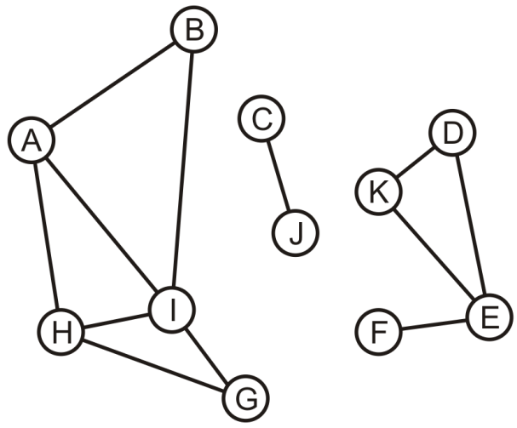
Connected Components
Here we start with a set of singletons
A | B | C | D | E | F | G | H | I | J | K
A | B | C | D | E | F | G | H | I | J | K

Slide 66
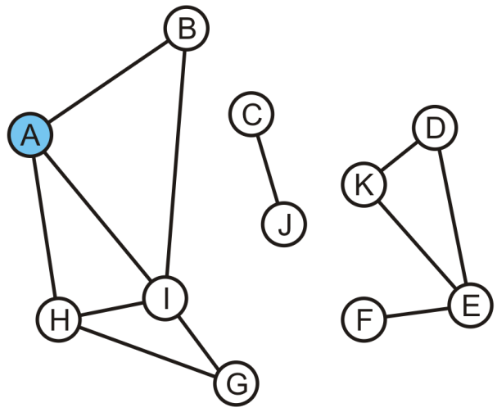
Connected Components
The vertex A is unvisited, so we start with it
A | B | C | D | E | F | G | H | I | J | K
A | B | C | D | E | F | G | H | I | J | K

Slide 67
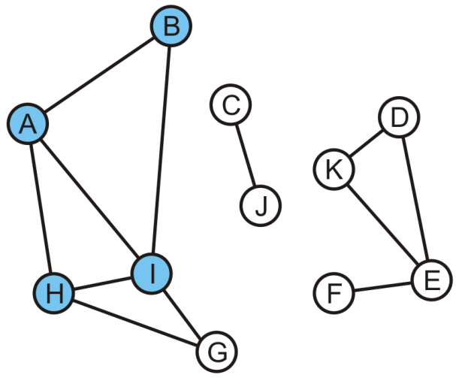
Connected Components
Take the union of with its adjacent vertices: {A, B, H, I}
A | B | C | D | E | F | G | H | I | J | K
A | A | C | D | E | F | G | A | A | J | K

Slide 68
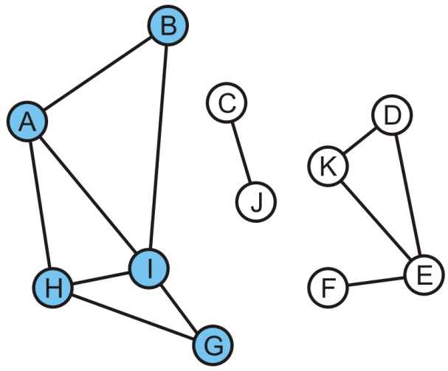
Connected Components
As the traversal continues, we take the union of the set {G} with the set containing H: {A, B, G, H, I}
The traversal is finished
A | B | C | D | E | F | G | H | I | J | K
A | A | C | D | E | F | A | A | A | J | K

Slide 69
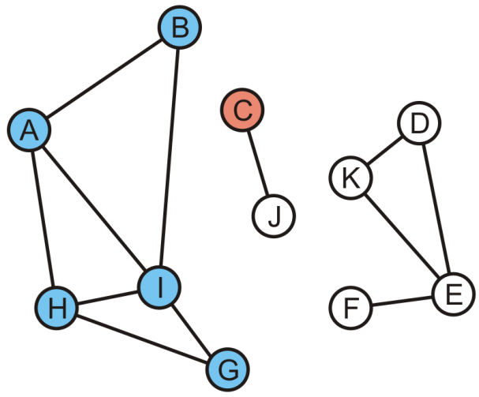
Connected Components
Start another traversal with C: this defines a new set {C}
A | B | C | D | E | F | G | H | I | J | K
A | A | C | D | E | F | A | A | A | J | K

Slide 70
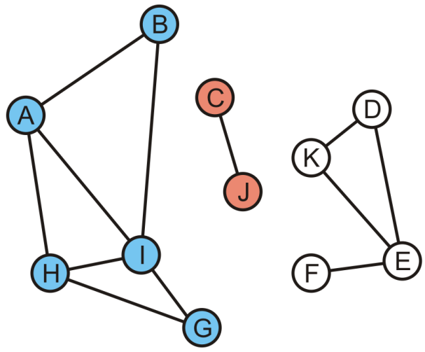
Connected Components
We take the union of {C} and its adjacent vertex J: {C, J}
This traversal is finished
A | B | C | D | E | F | G | H | I | J | K
A | A | C | D | E | F | A | A | A | C | K

Slide 71
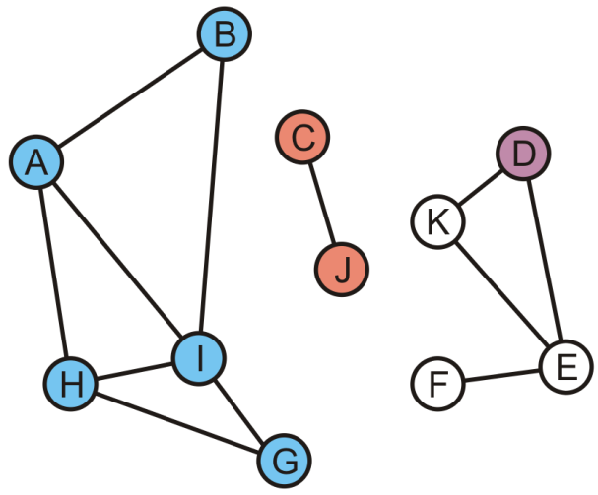
Connected Components
We start again with the set {D}
A | B | C | D | E | F | G | H | I | J | K
A | A | C | D | E | F | A | A | A | C | K

Slide 72
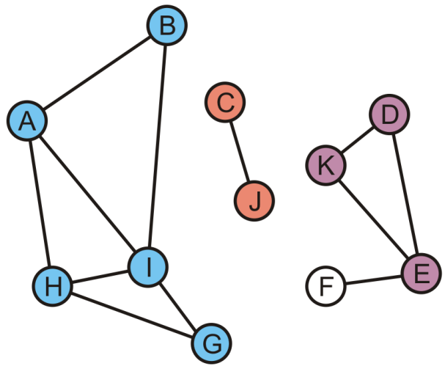
Connected Components
K and E are adjacent to D, so take the unions creating {D, E, K}
A | B | C | D | E | F | G | H | I | J | K
A | A | C | D | D | F | A | A | A | C | D

Slide 73
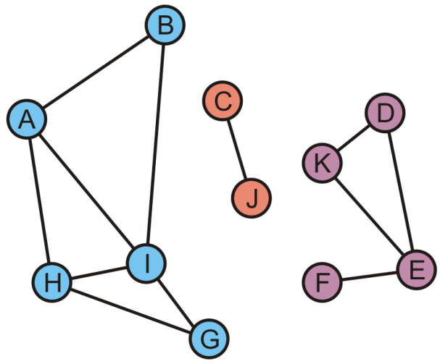
Connected Components
Finally, during this last traversal we find that F is adjacent to E
Take the union of {F} with the set containing E: {D, E, F, K}
A | B | C | D | E | F | G | H | I | J | K
A | A | C | D | D | D | A | A | A | C | D

Slide 74
Connected Components
All vertices are visited, so we are done
There are three connected sub-graphs {A, B, G, H, I}, {C, J}, {D, E, F, K}
A | B | C | D | E | F | G | H | I | J | K
A | A | C | D | D | D | A | A | A | C | D

Slide 75
Tracking Unvisited Vertices
The time complexity to find an unvisited vertex:
O(|V|)
How do you implement a list of unvisited vertices so as to:
Find an unvisited vertex in Ο(1) time
Remove a vertex that has been visited from this list in Ο(1) time?
The solution will use Ο(|V|) additional memory
Coding practice~

Slide 76
Tracking Unvisited Vertices
Create two arrays:
One array, unvisited, will contain the unvisited vertices
The other, loc_in_unvisited, will contain the location of vertex v_{i} in the first array
0 | 1 | 2 | 3 | 4 | 5 | 6 | 7 | 8 | 9 | 10
A | B | C | D | E | F | G | H | I | J | K
A | B | C | D | E | F | G | H | I | J | K
0 | 1 | 2 | 3 | 4 | 5 | 6 | 7 | 8 | 9 | 10

Slide 77
Tracking Unvisited Vertices
Suppose we visit D
D is in entry 3
0 | 1 | 2 | 3 | 4 | 5 | 6 | 7 | 8 | 9 | 10
A | B | C | D | E | F | G | H | I | J | K
A | B | C | D | E | F | G | H | I | J | K
0 | 1 | 2 | 3 | 4 | 5 | 6 | 7 | 8 | 9 | 10

Slide 78
Tracking Unvisited Vertices
Suppose we visit D
D is in entry 3
Copy the last unvisited vertex into this location and update the location array for this value
0 | 1 | 2 | 3 | 4 | 5 | 6 | 7 | 8 | 9 | 10
A | B | C | K | E | F | G | H | I | J
A | B | C | D | E | F | G | H | I | J | K
0 | 1 | 2 | 3 | 4 | 5 | 6 | 7 | 8 | 9 | 3

Slide 79
Tracking Unvisited Vertices
Suppose we visit G
G is in entry 6
0 | 1 | 2 | 3 | 4 | 5 | 6 | 7 | 8 | 9 | 10
A | B | C | K | E | F | G | H | I | J
A | B | C | D | E | F | G | H | I | J | K
0 | 1 | 2 | 3 | 4 | 5 | 6 | 7 | 8 | 9 | 3

Slide 80
Tracking Unvisited Vertices
Suppose we visit G
G is in entry 6
Copy the last unvisited vertex into this location and update the location array for this value
0 | 1 | 2 | 3 | 4 | 5 | 6 | 7 | 8 | 9 | 10
A | B | C | K | E | F | J | H | I
A | B | C | D | E | F | G | H | I | J | K
0 | 1 | 2 | 3 | 4 | 5 | 6 | 7 | 8 | 6 | 3

Slide 81
Tracking Unvisited Vertices
Suppose we now visit K
K is in entry 3
0 | 1 | 2 | 3 | 4 | 5 | 6 | 7 | 8 | 9 | 10
A | B | C | K | E | F | J | H | I
A | B | C | D | E | F | G | H | I | J | K
0 | 1 | 2 | 3 | 4 | 5 | 6 | 7 | 8 | 6 | 3

Slide 82
Tracking Unvisited Vertices
Suppose we now visit K
K is in entry 3
Copy the last unvisited vertex into this location and update the location array for this value
0 | 1 | 2 | 3 | 4 | 5 | 6 | 7 | 8 | 9 | 10
A | B | C | I | E | F | J | H
A | B | C | D | E | F | G | H | I | J | K
0 | 1 | 2 | 3 | 4 | 5 | 6 | 7 | 3 | 6 | 3

Slide 83
Tracking Unvisited Vertices
If we want to find an unvisited vertex, we simply return the last entry of the first array and return it
0 | 1 | 2 | 3 | 4 | 5 | 6 | 7 | 8 | 9 | 10
A | B | C | I | E | F | J | H
A | B | C | D | E | F | G | H | I | J | K
0 | 1 | 2 | 3 | 4 | 5 | 6 | 7 | 3 | 6 | 3

Slide 84
Tracking Unvisited Vertices
In this case, an unvisited vertex is H
Removing it is trivial: just decrement the count of unvisited vertices
0 | 1 | 2 | 3 | 4 | 5 | 6 | 7 | 8 | 9 | 10
A | B | C | I | E | F | J
A | B | C | D | E | F | G | H | I | J | K
0 | 1 | 2 | 3 | 4 | 5 | 6 | 7 | 3 | 6 | 3

Slide 85
Tracking Unvisited Vertices
The actual algorithm is exceptionally fast:
The initialization is Ο(|V|)
Determining if the vertex v_{k} is visited is fast: Ο(1)
Marking vertex v_{k} as having been visited is also fast: Ο(1)
Returning a vertex that is unvisited is also fast: Ο(1)
The idea/structure is for any scenario that needs to remove an item from a list (without any order limitation).
The other option: doubly linked list

Slide 86
Compute connected components with new data structure
We start with two arrays
0 | 1 | 2 | 3 | 4 | 5 | 6 | 7 | 8 | 9 | 10
A | B | C | D | E | F | G | H | I | J | K
A | B | C | D | E | F | G | H | I | J | K
0 | 1 | 2 | 3 | 4 | 5 | 6 | 7 | 8 | 9 | 10

Slide 87
Compute connected components with new data structure
The first unvisited vertex is K
Remove K
0 | 1 | 2 | 3 | 4 | 5 | 6 | 7 | 8 | 9 | 10
A | B | C | D | E | F | G | H | I | J | K
A | B | C | D | E | F | G | H | I | J | K
0 | 1 | 2 | 3 | 4 | 5 | 6 | 7 | 8 | 9 | 10
B
A
C
D
K
J
H
I
F
E
G

Slide 88
Compute connected components with new data structure
Visit D through the edge (K, D)
Copy J into location 3 and update the location array
0 | 1 | 2 | 3 | 4 | 5 | 6 | 7 | 8 | 9 | 10
A | B | C | J | E | F | G | H | I | J
A | B | C | D | E | F | G | H | I | J | K
0 | 1 | 2 | 3 | 4 | 5 | 6 | 7 | 8 | 3 | 10
B
A
C
D
K
J
H
I
F
E
G

Slide 89
Compute connected components with new data structure
Visit E through the edge (K, E)
Copy I into location 4 and update the location array
0 | 1 | 2 | 3 | 4 | 5 | 6 | 7 | 8 | 9 | 10
A | B | C | J | I | F | G | H | I
A | B | C | D | E | F | G | H | I | J | K
0 | 1 | 2 | 3 | 4 | 5 | 6 | 7 | 4 | 3 | 10
B
A
C
D
K
J
H
I
F
E
G

Slide 90
Compute connected components with new data structure
Visit F through the edge (E, F)
Copy H into location 5 and update the location array
0 | 1 | 2 | 3 | 4 | 5 | 6 | 7 | 8 | 9 | 10
A | B | C | J | I | H | G | H
A | B | C | D | E | F | G | H | I | J | K
0 | 1 | 2 | 3 | 4 | 5 | 6 | 5 | 4 | 3 | 10
B
A
C
D
K
J
H
I
F
E
G

Slide 91
Compute connected components with new data structure
BFS Queue is empty, one component {D, E, F, K} is found.
Then, we visit G
Remove G
0 | 1 | 2 | 3 | 4 | 5 | 6 | 7 | 8 | 9 | 10
A | B | C | J | I | H | G
A | B | C | D | E | F | G | H | I | J | K
0 | 1 | 2 | 3 | 4 | 5 | 6 | 5 | 4 | 3 | 10
B
A
C
D
K
J
H
I
F
E
G

Slide 92
Compute connected components with new data structure
Visit H through (G, H)
Remove H
0 | 1 | 2 | 3 | 4 | 5 | 6 | 7 | 8 | 9 | 10
A | B | C | J | I | H
A | B | C | D | E | F | G | H | I | J | K
0 | 1 | 2 | 3 | 4 | 5 | 6 | 5 | 4 | 3 | 10
B
A
C
D
K
J
H
I
F
E
G

Slide 93
Compute connected components with new data structure
Visit I
Remove I
0 | 1 | 2 | 3 | 4 | 5 | 6 | 7 | 8 | 9 | 10
A | B | C | J | I
A | B | C | D | E | F | G | H | I | J | K
0 | 1 | 2 | 3 | 4 | 5 | 6 | 5 | 4 | 3 | 10
B
A
C
D
K
J
H
I
F
E
G

Slide 94
Compute connected components with new data structure
Visit A
Copy J into location 0 and update the location array
0 | 1 | 2 | 3 | 4 | 5 | 6 | 7 | 8 | 9 | 10
J | B | C | J
A | B | C | D | E | F | G | H | I | J | K
0 | 1 | 2 | 3 | 4 | 5 | 6 | 5 | 4 | 0 | 10
B
A
C
D
K
J
H
I
F
E
G

Slide 95
Compute connected components with new data structure
Visit B
Copy C into location 1 and update the location array
0 | 1 | 2 | 3 | 4 | 5 | 6 | 7 | 8 | 9 | 10
J | C | C
A | B | C | D | E | F | G | H | I | J | K
0 | 1 | 1 | 3 | 4 | 5 | 6 | 5 | 4 | 0 | 10
B
A
C
D
K
J
H
I
F
E
G

Slide 96
Compute connected components with new data structure
Visit C
Remove C
0 | 1 | 2 | 3 | 4 | 5 | 6 | 7 | 8 | 9 | 10
J | C
A | B | C | D | E | F | G | H | I | J | K
0 | 1 | 1 | 3 | 4 | 5 | 6 | 5 | 4 | 0 | 10
B
A
C
D
K
J
H
I
F
E
G

Slide 97
Compute connected components with new data structure
Visit J
Remove J
0 | 1 | 2 | 3 | 4 | 5 | 6 | 7 | 8 | 9 | 10
A | B | C | D | E | F | G | H | I | J | K
0 | 1 | 1 | 3 | 4 | 5 | 6 | 5 | 4 | 0 | 10
B
A
C
D
K
J
H
I
F
E
G

Slide 98
Connected Component Detection
Coding practice~
Any other easier way to implement?

Slide 99
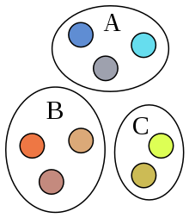
Disjoint set data structure
Consider n elements, named 1, 2, …, n
The disjoint set is a collection of sets of elements
Each element is in exactly one set
sets are disjoint
to start, each set contains one element
SetName = find ( elementName )
returns the name of the set that contains the given element
union ( SetName1, SetName2 )
union two sets together into a new set
How to quickly perform union and find operations?

Slide 100
Disjoint set data structure
Attempt 1: Quick Find
Array implementation. elements are 1, …, N
SetName[i] = name of the set containing element i
Pseudo code:
Initialize(int N)
SetName = new int [N+1];
for (int e=1; e<=N; e++)
SetName[e] = e;
Union(int i, int j)
for (int k=1; k<=N; k++)
if (SetName[k] == j) SetName[k] = i;
int Find(int e)
return SetName[e];
Time Complexity Analysis:
Find : O(1), Union : O(n)
Note: we usually use n to denote the number of vertices (i.e., |V|) and use m to denote the number of edges (i.e., |E|).

Slide 101


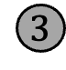

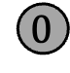


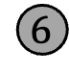

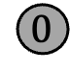
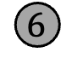





Disjoint Set data structure
Attempt 2: Smart Union: Union by Size
union(u, v): make smaller tree’s root point to bigger one’s root
That is, make v’s root point to u’s if v’s tree is smaller.
Union(4,5), union(6,7), union(4,6)
$$4$$
$$0$$
$$1$$
$$2$$
$$3$$
$$5$$
$$6$$
$$7$$
Now perform union(3, 4). Smaller tree made the child node.
$$4$$
$$0$$
$$1$$
$$2$$
$$3$$
$$5$$
$$6$$
$$7$$

Slide 102
Disjoint Set data structure
Initialize(int N)
setsize = new int[N+1];
parent = new int [N+1];
for (int e=1; e <= N; e++)
parent[e] = 0;
setsize[e] = 1;
int Find(int e)
while (parent[e] != 0)
e = parent[e];
return e;
Union(int i, int j)
i = find(i);
j = find(j)’
if setsize[i] < setsize[j]
then
setsize[j] += setsize[i];
parent[i] = j;
else
setsize[i] += setsize[j];
parent[j] = i ;
Union by Size:
link smaller tree to larger one
Lemma: After n union ops, the tree height is at most log(n).

Slide 103
Disjoint Set data structure
Time Complexity:
Find(u) takes time proportional to u’s depth in its tree.
When union(u, v) performed, the depth of u only increases if its root becomes the child of v’s root. That only happens if v’s tree is larger than u’s tree.
If u’s depth grows by 1, its (new) treeSize is > 2 * oldTreeSize
Each increment in depth doubles the size of u’s tree.
After n union operations, size is at most n, so depth at most log(n).
Theorem: With Union-By-Size, we can do find in O(log n) time and union in O(log(n)) time.

Slide 104




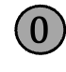






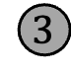
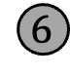



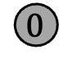







Disjoint Set data structure
int Find(int e)
if (parent[e] == 0)
return e
else
parent[e] = Find(parent[e])
return parent[e]
The Ultimate Union-Find: Path compression
While performing Find, direct all nodes on the path to the root.
Example: Find(10)
$$0$$
$$0$$
$$1$$
$$2$$
$$4$$
$$1$$
$$2$$
$$4$$
$$8$$
$$10$$
$$3$$
$$5$$
$$6$$
$$8$$
$$11$$
$$3$$
$$5$$
$$6$$
$$9$$
$$7$$
$$9$$
$$10$$
$$7$$
$$11$$

Slide 105
Disjoint Set data structure
The Ultimate Union-Find: Path compression
Any single find can still be O(log(n)), but later finds on the same path are faster
Union, Find: “almost linear” total time
Amortized O(1) time for each Union or Find.
int Find(int e)
if (parent[e] == 0)
return e
else
parent[e] = Find(parent[e])
return parent[e]

Slide 106
Check Connected Components by Disjoint Sets
We would like to find the connected components by using Disjoint Sets (Union Find).
List all edges in this graph (in alphabetical order):
{A,B}, {A,H}, {A,I}, {B,I}, {C,J}, {D,E}, {D,K}, {E,F},
{E,K}, {G,H}, {G,I}, {H,I}

Slide 107
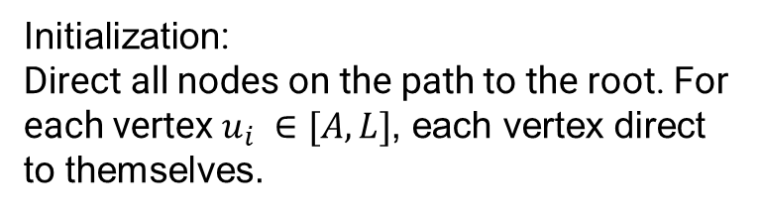

Check Connected Components by Disjoint Sets
{A, B}
{A, H}
{A, I}
{B, I}
{C, J}
{D, E}
{D, K}
{E, F}
{E, K}
{G, H}
{G, I}
{H, I}
Going through the example again with disjoint sets. We start with eleven singletons.
{A}, {B}, {C}, {D}, {E}, {F}, {G}, {H}, {I}, {J}, {K}
Initialization:
Direct all nodes on the path to the root. For each vertex $u_{i} ∈[A,L]$, each vertex direct to themselves.
$$u_{i}$$
Notes:
Initialization: all nodes direct to themselves. In the following slides, we only show the tree whose depth is larger than 1.

Slide 108

Check Connected Components by Disjoint Sets
We start by adding edge {A, B}
{A, B}
{A, H}
{A, I}
{B, I}
{C, J}
{D, E}
{D, K}
{E, F}
{E, K}
{G, H}
{G, I}
{H, I}
{A, B}, {C}, {D}, {E}, {F}, {G}, {H}, {I}, {J}, {K}
$$A$$
B

Slide 109


Check Connected Components by Disjoint Sets
We add edge {A, H}, {A, I}
{A, B}
{A, H}
{A, I}
{B, I}
{C, J}
{D, E}
{D, K}
{E, F}
{E, K}
{G, H}
{G, I}
{H, I}
{A, B, H, I}, {C}, {D}, {E}, {F}, {G}, {J}, {K}
Add {A,H}: According to the rule of Union by Size, make smaller tree H point to bigger one’s root A.
$$A$$
H
B
Add {A,I}:
$$A$$
I
H
B

Slide 110



Check Connected Components by Disjoint Sets
We add edge {B, I}, {C, J}
{A, B}
{A, H}
{A, I}
{B, I}
{C, J}
{D, E}
{D, K}
{E, F}
{E, K}
{G, H}
{G, I}
{H, I}
{A, B, H, I}, {C, J}, {D}, {E}, {F}, {G}, {K}
Add {B,I}: B and I are already in the tree, and they all point to the root. Thus, nothing will be changed.
$$A$$
I
H
B
Add {C,J}:
$$A$$
$$C$$
I
H
B
J

Slide 111





Check Connected Components by Disjoint Sets
We add edge {D, E}, {D, K}
{A, B}
{A, H}
{A, I}
{B, I}
{C, J}
{D, E}
{D, K}
{E, F}
{E, K}
{G, H}
{G, I}
{H, I}
{A, B, H, I}, {C, J}, {D, E, K}, {F}, {G}
Add {D,E}:
$$A$$
$$C$$
$$D$$
I
H
B
J
E
Add {D,K}:
$$A$$
$$C$$
$$D$$
I
H
B
J
K
E

Slide 112






Check Connected Components by Disjoint Sets
We add edge {E, F}, {E, K}
{A, B}
{A, H}
{A, I}
{B, I}
{C, J}
{D, E}
{D, K}
{E, F}
{E, K}
{G, H}
{G, I}
{H, I}
{A, B, H, I}, {C, J}, {D, E, F, K}, {G}
Add {E,F}:
$$A$$
$$C$$
$$D$$
I
H
B
J
K
E
F
Add {E,K}: E, K are already pointed to root D.
Thus, there is nothing change of adding {E,K}
$$A$$
$$C$$
$$D$$
I
H
B
J
K
E
F

Slide 113






Check Connected Components by Disjoint Sets
We add edge {G, H}, {G, I}, {H, I}
{A, B}
{A, H}
{A, I}
{B, I}
{C, J}
{D, E}
{D, K}
{E, F}
{E, K}
{G, H}
{G, I}
{H, I}
Add {G, H}:
$$A$$
$$C$$
$$D$$
I
H
B
G
J
K
E
F
Add {G, I}, {H, I}: G, H, I are already pointed to root A.
Thus, there is nothing change of adding {G, I}, {H, I}.
$$A$$
$$C$$
$$D$$
I
H
B
G
J
K
E
F
At last we get result: {A, B, G, H, I}, {C, J}, {D, E, F, K}

Slide 114
Check Connected Components by Disjoint Sets
Build the index: O(|V|+|E|)
Space: O(|V|)
Good for incremental connected components maintenance~
Coding practice~

Slide 115
Topological Sort

Slide 116
Topological Sort
In this topic, we will discuss:
Motivations
The definition of a directed acyclic graph (DAG)
Describe a topological sort and applications
Describe the algorithm
Do a run-time and memory analysis of the algorithm

Slide 117
Motivation
Given a set of tasks with dependencies,
is there an order in which we can complete the tasks?
Dependencies form a partial ordering
A partial ordering on a number of objects can be represented as a directed acyclic graph (DAG)
Notes:
The word partial in the names "partial order" and "partially ordered set" is used as an indication that not every pair of elements needs to be comparable. Partial orders thus generalize total orders, in which every pair is comparable.

Slide 118

Directed acyclic graph (DAG)
A directed acyclic graph (DAG) is a directed graph with no directed cycles.
https://en.wikipedia.org/wiki/Directed_acyclic_graph

Slide 119

Motivation
Cycles in dependencies can cause issues...
http://xkcd.com/754/
Another example: the precedence graph in database transaction management

Slide 120
Restriction of paths in DAGs
Observation:
In a DAG, given two different vertices v_{j} and v_{k}, there cannot both be a path from v_{j} to v_{k} and a path from v_{k} to v_{j.}
Definition:
A topological sorting of the vertices in a DAG is an ordering
v₁, v₂, v₃, …, v_{|V|}
such that if there is a path from v_{j} to v_{k} , v_{j} appears before v_{k}.
Notes:
The proof is easy. If there are two such paths, then they will form a cycle. In computer science, a topological sort or topological ordering of a directed graph is a linear ordering of its vertices such that for every directed edge uv from vertex u to vertex v, u comes before v in the ordering. For instance, the vertices of the graph may represent tasks to be performed, and the edges may represent constraints that one task must be performed before another; in this application, a topological ordering is just a valid sequence for the tasks. A topological ordering is possible if and only if the graph has no directed cycles, that is, if it is a directed acyclic graph (DAG). Any DAG has at least one topological ordering, and algorithms are known for constructing a topological ordering of any DAG in linear time. Topological sorting has many applications especially in ranking problems such as feedback arc set.

Slide 121

Definition of topological sorting
Given this DAG, a topological sort is H, C, I, D, J, A, F, B, G, K, E, L

Slide 122
Example
There are paths from H, C, I, D and J to F, so all these must come before F in a topological sort
H, C, I, D, J, A, F, B, G, K, E, L
Clearly, this sorting need not be unique

Slide 123

Applications
The following is a task graph for getting dressed:
One topological sort is:
briefs, pants, wallet, keys, belt, socks, shoes, shirt, tie, jacket, iPod, watch
Another topological sort is:
briefs, socks, pants, shirt, belt, tie, jacket, wallet, keys, iPod, watch, shoes

Slide 124
Topological Sort
Idea:
Given a DAG V, make a copy W and iterate:
Find a vertex v in W with in-degree zero (i.e., the source vertex)
Let v be the next vertex in the topological sort
Continue iterating with the vertex-induced sub-graph W \ {v}
Possible solutions:
C, H, D, A, B, I, J, F, G, E, K, L
H, I, J, C, D, F, G, K, L, A, B, E
Example:
Notes:
Choose a vertex v that has in-degree zero
Let v be the next vertex in our topological sort
Remove v and all edges connected to it

Slide 125
Analysis
What are the tools necessary for a topological sort?
We must know and be able to update the in-degrees of each of the vertices
We could do this with a table of the in-degrees of each of the vertices
This requires Ο(|V|) memory
A | 1
B | 1
C | 0
D | 2
E | 4
F | 2
G | 1
H | 0
I | 1
J | 1
K | 1
L | 2

Slide 126
Analysis
We must iterate at least |V| times, so the run-time must be Ο(|V|)
We need to find vertices with in-degree zero
We could loop through the array with each iteration
The run time would be O(|V|²)
A | 1
B | 1
C | 0
D | 2
E | 4
F | 2
G | 1
H | 0
I | 1
J | 1
K | 1
L | 2

Slide 127
Analysis
How did we do with BFS and DFS?
Use a queue (or other container) to temporarily store those vertices with in-degree zero
Each time the in-degree of a vertex is decremented to zero, push it onto the queue
A | 1
B | 1
C | 0
D | 2
E | 4
F | 2
G | 1
H | 0
I | 1
J | 1
K | 1
L | 2

Slide 128
Analysis
What are the run times associated with the queue?
Initially, we must scan through each of the vertices: Ο(|V|)
For each vertex, we will have to push onto and pop off the queue once, also Ο(|V|)
A | 1
B | 1
C | 0
D | 2
E | 4
F | 2
G | 1
H | 0
I | 1
J | 1
K | 1
L | 2

Slide 129
Analysis
Finally, each value in the in-degree table is associated with an edge
Here, |E| = 16
Each of the in-degrees must be decremented to zero
The run time of these operations is Ο(|E|)
If we are using an adjacency matrix: Ο(|V|²)
If we are using an adjacency list: Ο(|E|)
A | 1
B | 1
C | 0
D | 2
E | 4
F | 2
G | 1
H | 0
I | 1
J | 1
K | 1
L | 2
+
+
+
+
+
+
+
+
+
+
+
16

Slide 130
Analysis
Therefore, the run time of a topological sort is:
Ο(|V| + |E|) if we use an adjacency list
Ο(|V|²) if we use an adjacency matrix
and the additional memory requirements is Ο(|V|)
A | 1
B | 1
C | 0
D | 2
E | 4
F | 2
G | 1
H | 0
I | 1
J | 1
K | 1
L | 2

Slide 131
Analysis
What happens if at some step, all remaining vertices have an in-degree greater than zero?
There must be at least one cycle within that sub-set of vertices
Consequence: we now have an Ο(|V| + |E|) algorithm for determining if a graph has a cycle
A | 1
B | 1
C | 0
D | 2
E | 4
F | 2
G | 1
H | 0
I | 1
J | 1
K | 1
L | 2

Slide 132
Implementation
Thus, to implement a topological sort:
Allocate memory for and initialize an array of in-degrees
Create a queue and initialize it with all vertices that have in-degree zero
While the queue is not empty:
Pop a vertex from the queue
Decrement the in-degree of each neighbor
Those neighbors whose in-degree was decremented to zero are pushed onto the queue

Slide 133
Example
With the previous example, we initialize:
The array of in-degrees
The queue
A | 1
B | 1
C | 0
D | 2
E | 4
F | 2
G | 1
H | 0
I | 1
J | 1
K | 1
L | 2
Queue:
The queue is empty

Slide 134
Example
Stepping through the table, push all source vertices into the queue
A | 1
B | 1
C | 0
D | 2
E | 4
F | 2
G | 1
H | 0
I | 1
J | 1
K | 1
L | 2
Queue:

Slide 135
Example
Stepping through the table, push all source vertices into the queue
A | 1
B | 1
C | 0
D | 2
E | 4
F | 2
G | 1
H | 0
I | 1
J | 1
K | 1
L | 2
Queue:
C | H

Slide 136
Example
Pop the front of the queue
A | 1
B | 1
C | 0
D | 2
E | 4
F | 2
G | 1
H | 0
I | 1
J | 1
K | 1
L | 2
Queue:
C | H

Slide 137
Example
Pop the front of the queue
C has one neighbor: D
A | 1
B | 1
C | 0
D | 2
E | 4
F | 2
G | 1
H | 0
I | 1
J | 1
K | 1
L | 2
Queue:
C | H

Slide 138
Example
Pop the front of the queue
C has one neighbor: D
Decrement its in-degree
A | 1
B | 1
C | 0
D | 1
E | 4
F | 2
G | 1
H | 0
I | 1
J | 1
K | 1
L | 2
Queue:
C | H

Slide 139
Example
Pop the front of the queue
A | 1
B | 1
C | 0
D | 1
E | 4
F | 2
G | 1
H | 0
I | 1
J | 1
K | 1
L | 2
Queue:
C | H

Slide 140
Example
Pop the front of the queue
H has two neighbors: D and I
A | 1
B | 1
C | 0
D | 1
E | 4
F | 2
G | 1
H | 0
I | 1
J | 1
K | 1
L | 2
Queue:
C | H

Slide 141
Example
Pop the front of the queue
H has two neighbors: D and I
Decrement their in-degrees
A | 1
B | 1
C | 0
D | 0
E | 4
F | 2
G | 1
H | 0
I | 0
J | 1
K | 1
L | 2
Queue:
C | H

Slide 142
Example
Pop the front of the queue
H has two neighbors: D and I
Decrement their in-degrees
Both are decremented to zero, so push them onto the queue
A | 1
B | 1
C | 0
D | 0
E | 4
F | 2
G | 1
H | 0
I | 0
J | 1
K | 1
L | 2
Queue:
C | H

Slide 143
Example
Pop the front of the queue
H has two neighbors: D and I
Decrement their in-degrees
Both are decremented to zero, so push them onto the queue
A | 1
B | 1
C | 0
D | 0
E | 4
F | 2
G | 1
H | 0
I | 0
J | 1
K | 1
L | 2
Queue:
C | H | D | I

Slide 144
Example
Pop the front of the queue
A | 1
B | 1
C | 0
D | 0
E | 4
F | 2
G | 1
H | 0
I | 0
J | 1
K | 1
L | 2
Queue:
C | H | D | I

Slide 145
Example
Pop the front of the queue
D has three neighbors: A, E and F
A | 1
B | 1
C | 0
D | 0
E | 4
F | 2
G | 1
H | 0
I | 0
J | 1
K | 1
L | 2
Queue:
C | H | D | I

Slide 146
Example
Pop the front of the queue
D has three neighbors: A, E and F
Decrement their in-degrees
A | 0
B | 1
C | 0
D | 0
E | 3
F | 1
G | 1
H | 0
I | 0
J | 1
K | 1
L | 2
Queue:
C | H | D | I

Slide 147
Example
Pop the front of the queue
D has three neighbors: A, E and F
Decrement their in-degrees
A is decremented to zero, so push it onto the queue
A | 0
B | 1
C | 0
D | 0
E | 3
F | 1
G | 1
H | 0
I | 0
J | 1
K | 1
L | 2
Queue:
C | H | D | I | A

Slide 148
Example
Pop the front of the queue
A | 0
B | 1
C | 0
D | 0
E | 3
F | 1
G | 1
H | 0
I | 0
J | 1
K | 1
L | 2
Queue:
C | H | D | I | A

Slide 149
Example
Pop the front of the queue
I has one neighbor: J
A | 0
B | 1
C | 0
D | 0
E | 3
F | 1
G | 1
H | 0
I | 0
J | 1
K | 1
L | 2
Queue:
C | H | D | I | A

Slide 150
Example
Pop the front of the queue
I has one neighbor: J
Decrement its in-degree
A | 0
B | 1
C | 0
D | 0
E | 3
F | 1
G | 1
H | 0
I | 0
J | 0
K | 1
L | 2
Queue:
C | H | D | I | A

Slide 151
Example
Pop the front of the queue
I has one neighbor: J
Decrement its in-degree
J is decremented to zero, so push it onto the queue
A | 0
B | 1
C | 0
D | 0
E | 3
F | 1
G | 1
H | 0
I | 0
J | 0
K | 1
L | 2
Queue:
C | H | D | I | A | J

Slide 152
Example
Pop the front of the queue
A | 0
B | 1
C | 0
D | 0
E | 3
F | 1
G | 1
H | 0
I | 0
J | 0
K | 1
L | 2
Queue:
C | H | D | I | A | J

Slide 153
Example
Pop the front of the queue
A has one neighbor: B
A | 0
B | 1
C | 0
D | 0
E | 3
F | 1
G | 1
H | 0
I | 0
J | 0
K | 1
L | 2
Queue:
C | H | D | I | A | J

Slide 154
Example
Pop the front of the queue
A has one neighbor: B
Decrement its in-degree
A | 0
B | 0
C | 0
D | 0
E | 3
F | 1
G | 1
H | 0
I | 0
J | 0
K | 1
L | 2
Queue:
C | H | D | I | A | J

Slide 155
Example
Pop the front of the queue
A has one neighbor: B
Decrement its in-degree
B is decremented to zero, so push it onto the queue
A | 0
B | 0
C | 0
D | 0
E | 3
F | 1
G | 1
H | 0
I | 0
J | 0
K | 1
L | 2
Queue:
C | H | D | I | A | J | B

Slide 156
Example
Pop the front of the queue
A | 0
B | 0
C | 0
D | 0
E | 3
F | 1
G | 1
H | 0
I | 0
J | 0
K | 1
L | 2
Queue:
C | H | D | I | A | J | B

Slide 157
Example
Pop the front of the queue
J has one neighbor: F
A | 0
B | 0
C | 0
D | 0
E | 3
F | 1
G | 1
H | 0
I | 0
J | 0
K | 1
L | 2
Queue:
C | H | D | I | A | J | B

Slide 158
Example
Pop the front of the queue
J has one neighbor: F
Decrement its in-degree
A | 0
B | 0
C | 0
D | 0
E | 3
F | 0
G | 1
H | 0
I | 0
J | 0
K | 1
L | 2
Queue:
C | H | D | I | A | J | B

Slide 159
Example
Pop the front of the queue
J has one neighbor: F
Decrement its in-degree
F is decremented to zero, so push it onto the queue
A | 0
B | 0
C | 0
D | 0
E | 3
F | 0
G | 1
H | 0
I | 0
J | 0
K | 1
L | 2
Queue:
C | H | D | I | A | J | B | F

Slide 160
Example
Pop the front of the queue
A | 0
B | 0
C | 0
D | 0
E | 3
F | 0
G | 1
H | 0
I | 0
J | 0
K | 1
L | 2
Queue:
C | H | D | I | A | J | B | F

Slide 161
Example
Pop the front of the queue
B has one neighbor: E
A | 0
B | 0
C | 0
D | 0
E | 3
F | 0
G | 1
H | 0
I | 0
J | 0
K | 1
L | 2
Queue:
C | H | D | I | A | J | B | F

Slide 162
Example
Pop the front of the queue
B has one neighbor: E
Decrement its in-degree
A | 0
B | 0
C | 0
D | 0
E | 2
F | 0
G | 1
H | 0
I | 0
J | 0
K | 1
L | 2
Queue:
C | H | D | I | A | J | B | F

Slide 163
Example
Pop the front of the queue
A | 0
B | 0
C | 0
D | 0
E | 2
F | 0
G | 1
H | 0
I | 0
J | 0
K | 1
L | 2
Queue:
C | H | D | I | A | J | B | F

Slide 164
Example
Pop the front of the queue
F has three neighbors: E, G and K
A | 0
B | 0
C | 0
D | 0
E | 2
F | 0
G | 1
H | 0
I | 0
J | 0
K | 1
L | 2
Queue:
C | H | D | I | A | J | B | F

Slide 165
Example
Pop the front of the queue
F has three neighbors: E, G and K
Decrement their in-degrees
A | 0
B | 0
C | 0
D | 0
E | 1
F | 0
G | 0
H | 0
I | 0
J | 0
K | 0
L | 2
Queue:
C | H | D | I | A | J | B | F

Slide 166
Example
Pop the front of the queue
F has three neighbors: E, G and K
Decrement their in-degrees
G and K are decremented to zero, so push them onto the queue
A | 0
B | 0
C | 0
D | 0
E | 1
F | 0
G | 0
H | 0
I | 0
J | 0
K | 0
L | 2
Queue:
C | H | D | I | A | J | B | F | G | K

Slide 167
Example
Pop the front of the queue
A | 0
B | 0
C | 0
D | 0
E | 1
F | 0
G | 0
H | 0
I | 0
J | 0
K | 0
L | 2
Queue:
C | H | D | I | A | J | B | F | G | K

Slide 168
Example
Pop the front of the queue
G has two neighbors: E and L
A | 0
B | 0
C | 0
D | 0
E | 1
F | 0
G | 0
H | 0
I | 0
J | 0
K | 0
L | 2
Queue:
C | H | D | I | A | J | B | F | G | K

Slide 169
Example
Pop the front of the queue
G has two neighbors: E and L
Decrement their in-degrees
A | 0
B | 0
C | 0
D | 0
E | 0
F | 0
G | 0
H | 0
I | 0
J | 0
K | 0
L | 1
Queue:
C | H | D | I | A | J | B | F | G | K

Slide 170
Example
Pop the front of the queue
G has two neighbors: E and L
Decrement their in-degrees
E is decremented to zero, so push it onto the queue
A | 0
B | 0
C | 0
D | 0
E | 0
F | 0
G | 0
H | 0
I | 0
J | 0
K | 0
L | 1
Queue:
C | H | D | I | A | J | B | F | G | K | E

Slide 171
Example
Pop the front of the queue
A | 0
B | 0
C | 0
D | 0
E | 0
F | 0
G | 0
H | 0
I | 0
J | 0
K | 0
L | 1
Queue:
C | H | D | I | A | J | B | F | G | K | E

Slide 172
Example
Pop the front of the queue
K has one neighbors: L
A | 0
B | 0
C | 0
D | 0
E | 0
F | 0
G | 0
H | 0
I | 0
J | 0
K | 0
L | 1
Queue:
C | H | D | I | A | J | B | F | G | K | E

Slide 173
Example
Pop the front of the queue
K has one neighbors: L
Decrement its in-degree
A | 0
B | 0
C | 0
D | 0
E | 0
F | 0
G | 0
H | 0
I | 0
J | 0
K | 0
L | 0
Queue:
C | H | D | I | A | J | B | F | G | K | E

Slide 174
Example
Pop the front of the queue
K has one neighbors: L
Decrement its in-degree
L is decremented to zero, so push it onto the queue
A | 0
B | 0
C | 0
D | 0
E | 0
F | 0
G | 0
H | 0
I | 0
J | 0
K | 0
L | 0
Queue:
C | H | D | I | A | J | B | F | G | K | E | L

Slide 175
Example
Pop the front of the queue
A | 0
B | 0
C | 0
D | 0
E | 0
F | 0
G | 0
H | 0
I | 0
J | 0
K | 0
L | 0
Queue:
C | H | D | I | A | J | B | F | G | K | E | L

Slide 176
Example
Pop the front of the queue
E has no neighbors—it is a sink
A | 0
B | 0
C | 0
D | 0
E | 0
F | 0
G | 0
H | 0
I | 0
J | 0
K | 0
L | 0
Queue:
C | H | D | I | A | J | B | F | G | K | E | L

Slide 177
Example
Pop the front of the queue
A | 0
B | 0
C | 0
D | 0
E | 0
F | 0
G | 0
H | 0
I | 0
J | 0
K | 0
L | 0
Queue:
C | H | D | I | A | J | B | F | G | K | E | L

Slide 178
Example
Pop the front of the queue
L has no neighbors—it is also a sink
A | 0
B | 0
C | 0
D | 0
E | 0
F | 0
G | 0
H | 0
I | 0
J | 0
K | 0
L | 0
Queue:
C | H | D | I | A | J | B | F | G | K | E | L

Slide 179
Example
The queue is empty, so we are done
A | 0
B | 0
C | 0
D | 0
E | 0
F | 0
G | 0
H | 0
I | 0
J | 0
K | 0
L | 0
Queue:
C | H | D | I | A | J | B | F | G | K | E | L

Slide 180
Example
The enqueue order is the topological sorting
A | 0
B | 0
C | 0
D | 0
E | 0
F | 0
G | 0
H | 0
I | 0
J | 0
K | 0
L | 0
C | H | D | I | A | J | B | F | G | K | E | L

Slide 181
Exercise
Can you compute the topological sort of the following graph?
A
E
D
C
B

Slide 182
Exercise
Initialize the array of in-degrees and the queue
A | 0
B | 1
C | 2
D | 1
E | 2
A
E
D
C
B
Queue:
The queue is empty

Slide 183
Exercise
Push A onto the queue
A | 0
B | 1
C | 2
D | 1
E | 2
A
E
D
C
B
Queue:
A

Slide 184
Exercise
Pop the front of the queue
A has two neighbors: D and E
A | 0
B | 1
C | 2
D | 1
E | 2
A
E
D
C
B
Queue:
A

Slide 185
Exercise
Pop the front of the queue
A has two neighbors: D and E
Decrement their in-degree
A | 0
B | 1
C | 2
D | 0
E | 1
A
E
D
C
B
Queue:
A

Slide 186
Exercise
Pop the front of the queue
A has two neighbors: D and E
Decrement their in-degree
A | 0
B | 1
C | 2
D | 0
E | 1
A
E
D
C
B
Queue:
A | D
D is decremented to zero, so push it onto the queue

Slide 187
Exercise
Pop the front of the queue
D has two neighbors: B and C
A | 0
B | 1
C | 2
D | 0
E | 1
A
E
D
C
B
Queue:
A | D

Slide 188
Exercise
Pop the front of the queue
D has two neighbors: B and C
Decrement their in-degree
A | 0
B | 0
C | 1
D | 0
E | 1
A
E
D
C
B
Queue:
A | D

Slide 189
Exercise
Pop the front of the queue
D has two neighbors: B and C
Decrement their in-degree
A | 0
B | 0
C | 1
D | 0
E | 1
A
E
D
C
B
Queue:
A | D | B
B is decremented to zero, so push it onto the queue

Slide 190
Exercise
Pop the front of the queue
B has one neighbor: C
A | 0
B | 0
C | 1
D | 0
E | 1
A
E
D
C
B
Queue:
A | D | B

Slide 191
Exercise
Pop the front of the queue
B has one neighbor: C
Decrement its in-degree
A | 0
B | 0
C | 0
D | 0
E | 1
A
E
D
C
B
Queue:
A | D | B

Slide 192
Exercise
Pop the front of the queue
B has one neighbor: C
Decrement its in-degree
A | 0
B | 0
C | 0
D | 0
E | 1
A
E
D
C
B
Queue:
A | D | B | C
C is decremented to zero, so push it onto the queue

Slide 193
Exercise
Pop the front of the queue
C has one neighbor: E
A | 0
B | 0
C | 0
D | 0
E | 1
A
E
D
C
B
Queue:
A | D | B | C

Slide 194
Exercise
Pop the front of the queue
C has one neighbor: E
Decrement its in-degree
A | 0
B | 0
C | 0
D | 0
E | 0
A
E
D
C
B
Queue:
A | D | B | C

Slide 195
Exercise
Pop the front of the queue
C has one neighbor: E
Decrement its in-degree
A | 0
B | 0
C | 0
D | 0
E | 0
A
E
D
C
B
Queue:
A | D | B | C | E
E is decremented to zero, so push it onto the queue

Slide 196
Exercise
Pop the front of the queue
E has no neighbors
A | 0
B | 0
C | 0
D | 0
E | 0
A
E
D
C
B
Queue:
A | D | B | C | E

Slide 197
Exercise
The queue is empty, so we are done
A | 0
B | 0
C | 0
D | 0
E | 0
A
E
D
C
B
Queue:
A | D | B | C | E

Slide 198
Learning outcomes
Understand the BFS and DFS algorithms
Understand the algorithms for computing connected components (using BFS and Disjoint-set)
Know the concept of topological sort and how to compute it

